Slide 2
Session 5: Introduction to Graph Theory
Important Terminology
Vertices and Edges
Degrees and Degree Sequences
Some Theorems
5.1 What is a graph?
5.2 Paths, cycles and connectivity
5.3 Isomorphism of graphs
5.4 Adjacency matrices and adjacency lists

Slide 3
Definitions
define the terms incidence, adjacency, degree of a vertex;
state and apply a result concerning the connection between the sum of the degrees of the
vertices of a given graph and the number of its edges;
say what is meant by an r-regular graph;
draw a complete graph on n vertices for small integers n.

Slide 4
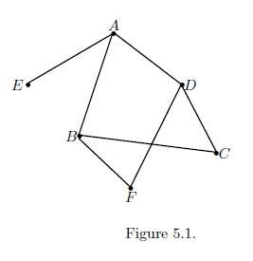
Basic Definitions

Slide 5
Important Theorems
Results 5.3 and 5.5
Let G be a graph. Then the sum of the degrees of the vertices of G is equal to twice the number of edges of G.
In any graph, the sum of the degrees of the vertices is an even integer.

Slide 6
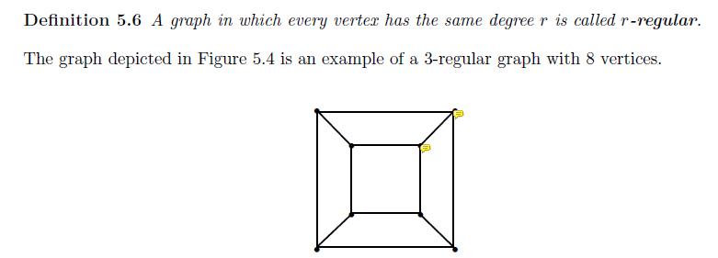
5.1 Definitions

Slide 7
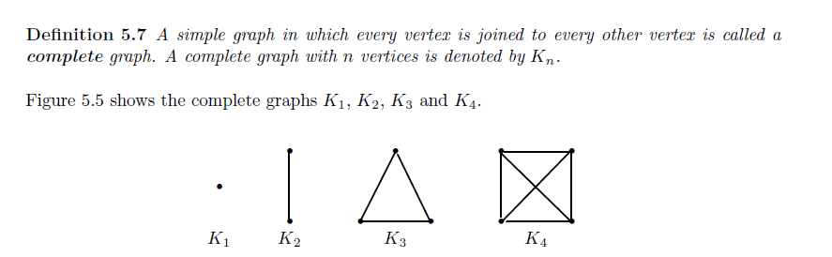
5.1 Definitions

Slide 8
Section 5.2
Definition 5.8 - A path is an alternating sequence of vertices.
(All the vertices and all the edges are distinct).
Definition 5.9 - The length of a path is the number of edges in it.
Definition 5.10 - A cycle is a path that begins and ends on the same vertex.

Slide 9
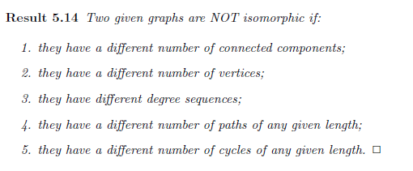
Isomorphism

Slide 10
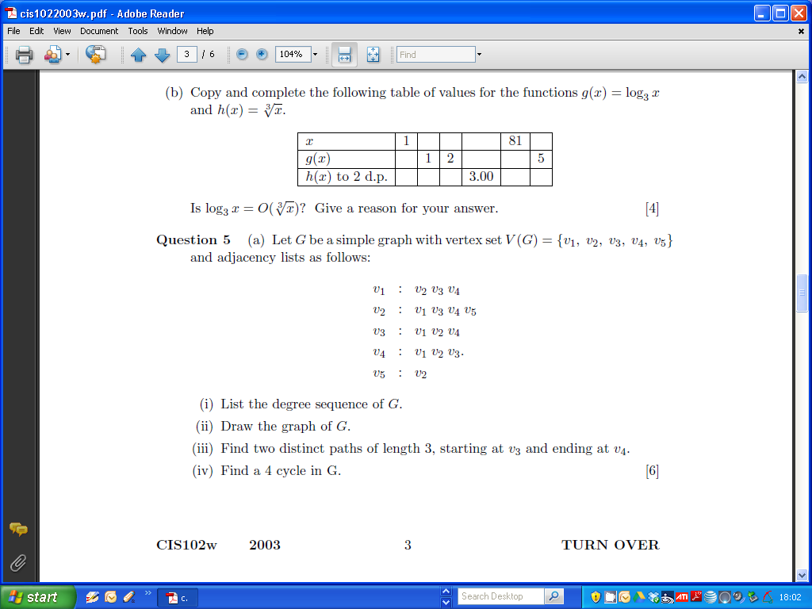
2003 Question

Slide 11
2003 Question

Slide 12
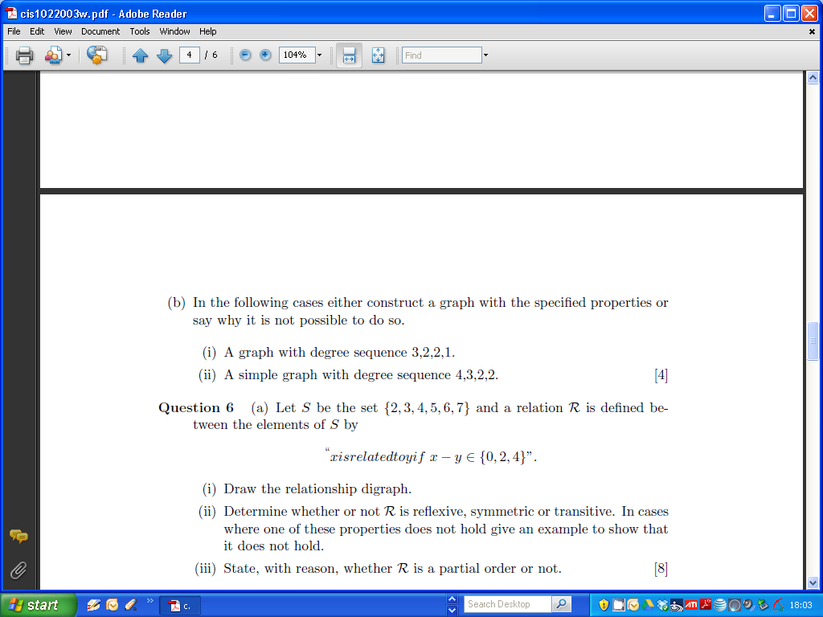
2003

Slide 13
Blank Slide

Slide 14
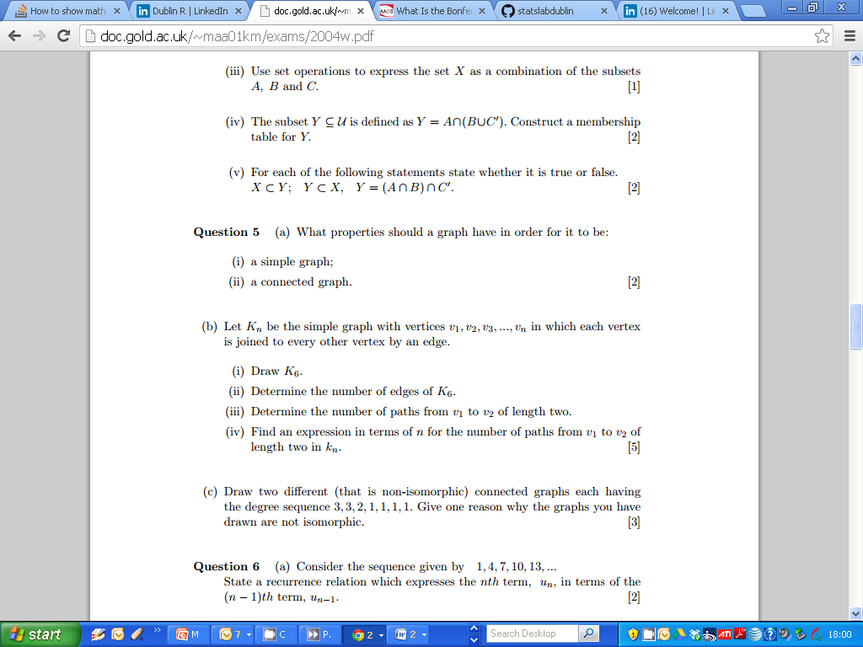
2004

Slide 15
2004

Slide 16
2004

Slide 17
Blank Slide

Slide 18
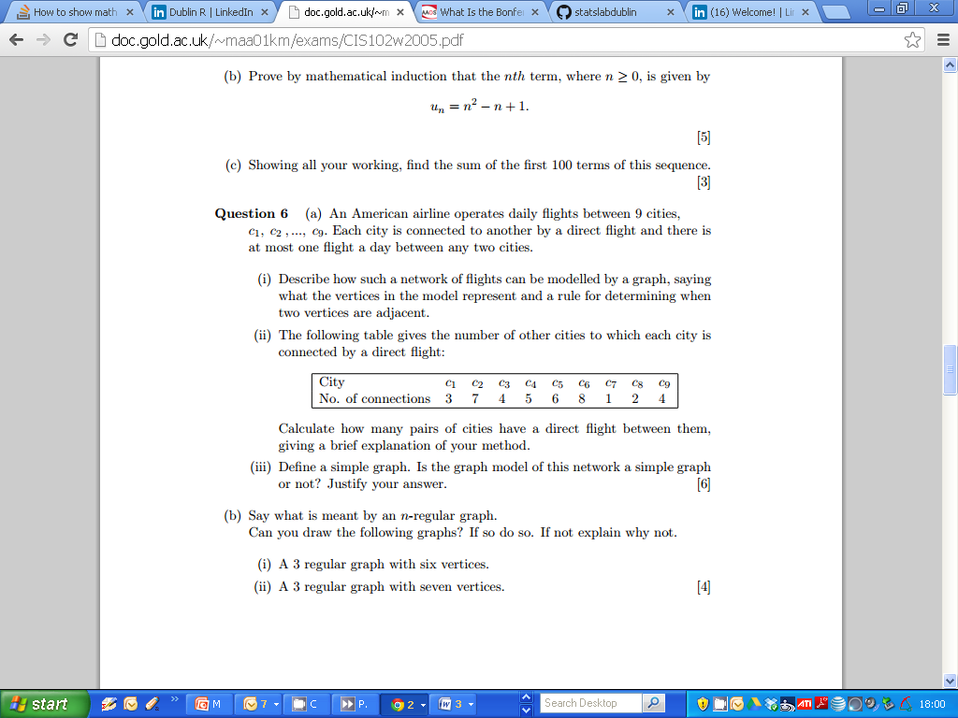
2005

Slide 19
2005

Slide 20
2005

Slide 21
Blank Slide

Slide 22
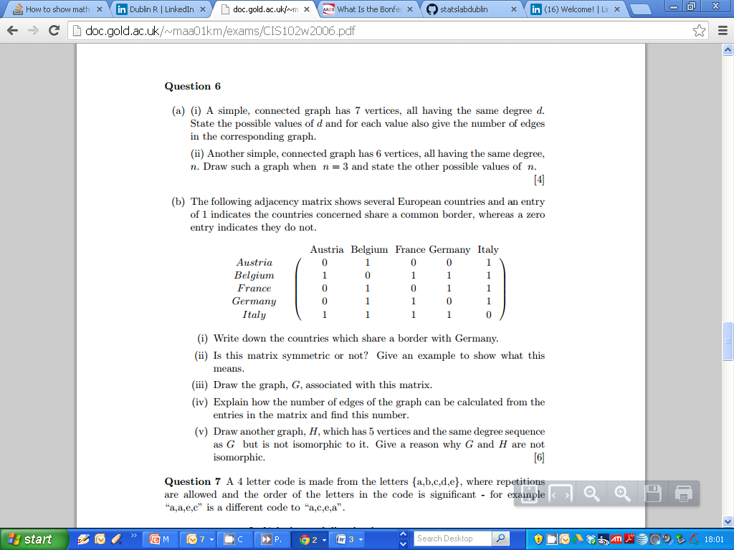
2006

Slide 23
2006

Slide 24
2006

Slide 25
Blank Slide

Slide 26
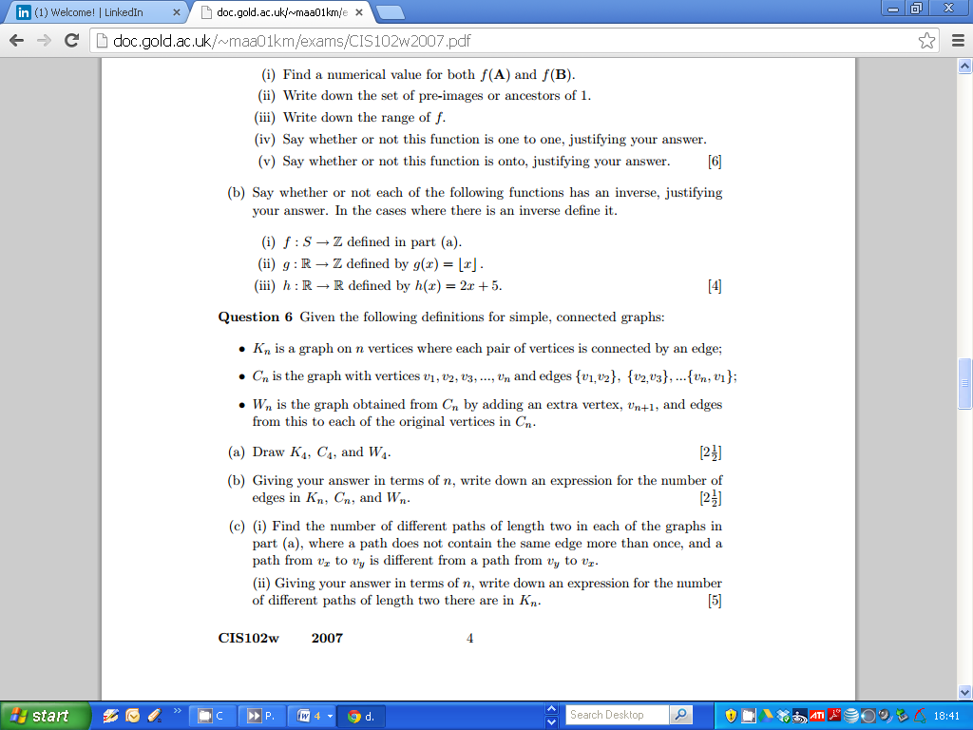
2007

Slide 27
2007

Slide 28
2007

Slide 29
Titles sentence case, Arial 22pt, Bold, black, max 30
First-level pt, sentence case, Arial, 18 pt, black
Second-level pt, sentence case, Arial, 16 pt, black
Third-level pt, sentence case, Arial, 14 pt, black
14 pt is the smallest font size permitted.
Do not insert an extra line space between bullets unless it is required for clarity or the layout of the slide would not work without the extra space.
There should be no extra line space added between a heading/lead-in and the list that follows it.

